Slide 1

Chapter 5:
Probability
^{Discovering Statistics}
^{2nd Edition Daniel T. Larose}
Lecture PowerPoint Slides
Notes:
Basic Practice of Statistics - 3rd Edition
Chapter 5

Slide 2

Chapter 5 Overview
5.1 Introducing Probability
5.2 Combining Events
5.3 Conditional Probability
5.4 Counting Methods

Slide 3
The Big Picture
Where we are coming from and where we are headed…
Chapters 1-4 dealt with descriptive statistics that summarize data. In later chapters, we will learn inferential statistics, which generalize from a sample to a population. But generalizing involves uncertainty.
Chapter 5 teaches us the language of uncertainty: probability. We will learn how to quantify uncertainty using experiments, events, outcomes, rules for combining events, conditional probability, and counting methods.
In Chapter 6, we will learn about the two most important probability distributions, the normal and the binomial, which will be our companions for the remainder of the text.

Slide 4
5.1: Introducing Probability
Objectives:
Understand the meaning of an experiment, an outcome, an event, and a sample space.
Describe the classical method of assigning probability.
Explain the Law of Large Numbers and the relative frequency method of assigning probability.

Slide 5
Building Blocks of Probability
Our daily lives are filled with uncertainty, seemingly governed by chance. We try to cope with uncertainty by estimating the chances a particular event will occur.
The probability of an outcome is defined as the long-term proportion of times the outcome occurs.
Experiment: any activity for which the outcome is uncertain.
Outcome: each possible result of the experiment.
Sample Space S: the collection of all possible outcomes.
Event: a collection of outcomes from the sample space. To find the probability of an event, add up the probabilities of all the outcomes in the event.

Slide 6
Rules of Probability
P(A) stands for “the probability that outcome A occurred.”
Rules of Probability
The probability P(E) for any event E is always between 0 and 1, inclusive. That is, 0 ≤ P(E) ≤ 1.
The Law of Total Probability: For any experiment, the sum of all the outcome probabilities in the sample space must equal 1.
Probability Value Meaning
Equal to 0 Outcome or event cannot occur
Near 0 Outcome or event is very unlikely
Low Outcome or event is unusual
High Outcome or event is not unusual
Near 1 Outcome or event is nearly certain to occur
Equal to 1 Outcome or event is certain to occur

Slide 7

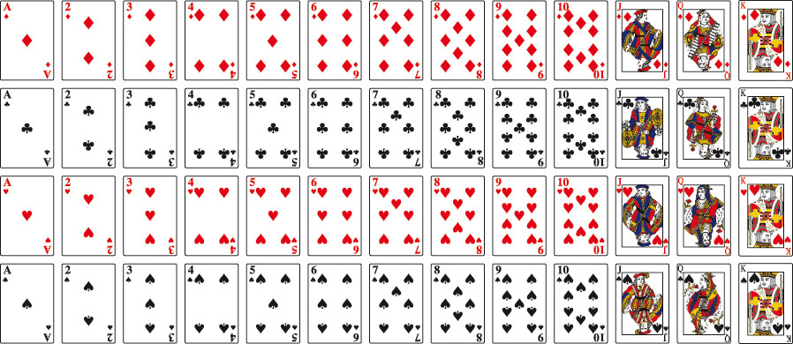
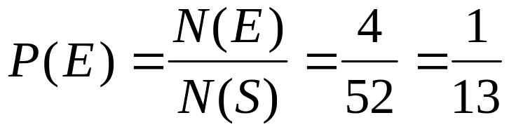
Classical Method of Assigning Probability
Find the probability of drawing an ace from a fair deck of cards.

Slide 8
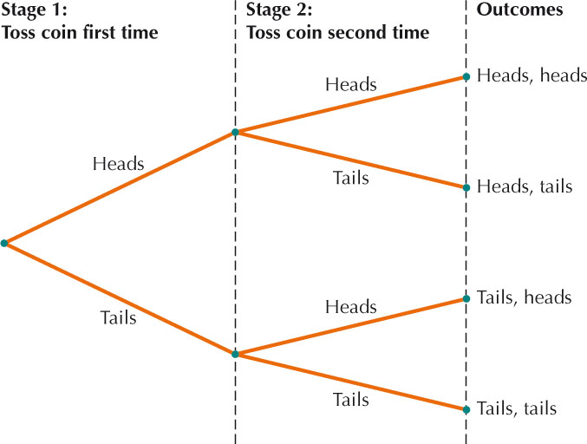

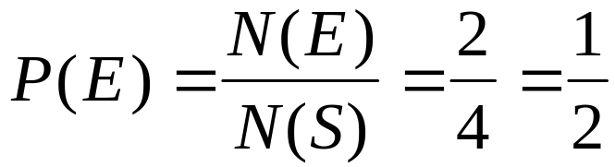
Tree Diagrams
A tree diagram is a graphical display that allows us to list all the outcomes in the sample space of a multistage experiment.
Find the probability of obtaining one head and one tails when tossing a fair coin twice.

Slide 9
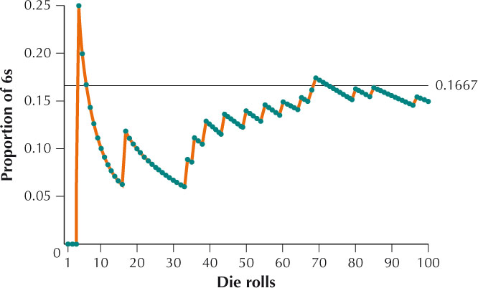
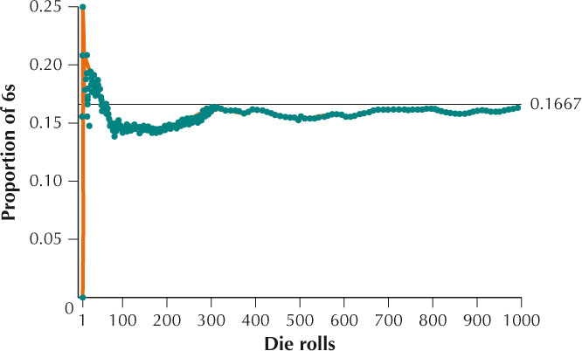
Relative Frequency Method
Suppose we wish to investigate the proportion of 6s we observe if we roll a fair die 100 times. We can use technology to perform a simulation to observe the “long-term proportion.”
Law of Large Numbers
As the number of times an experiment is repeated increases, the relative frequency of a particular outcome tends to approach the probability of the outcome.

Slide 10
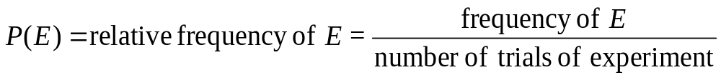
Relative Frequency Method
If we can’t use the classical method for assigning probabilities, then the Law of Large Numbers gives us a hint about how we can estimate the probability of an event.
Relative Frequency Method of Assigning Probabilities
The probability of event E is approximately equal to the relative frequency of event E. That is,
The relative frequency method is also known as the empirical method.

Slide 11
Subjective Method
There are cases where the outcomes are not equally likely and there has been no previous research, so neither the classical method nor relative frequency approach apply.
Subjective probability refers to the assignment of a probability value to an outcome based on personal judgment.

Slide 12
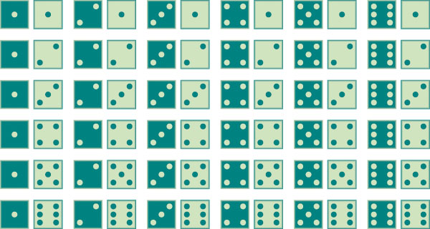
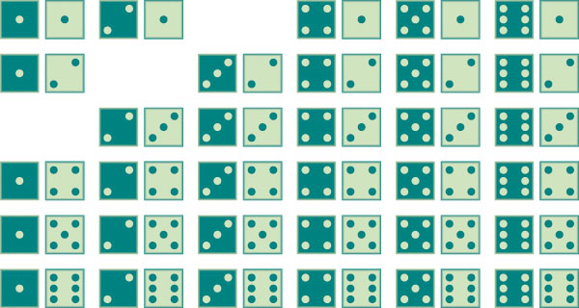
Complement
If A is an event, then the collection of events not in event A is called the complement of A, denoted A^{C}.
A = sum of 4
A^{C} = sum not equal to 4
Probabilities for Complements
For any event A and its complement A^{C}, P(A) + P(A^{C}) = 1.
P(A) = 1 – P(A^{C})
P(A^{C}) = 1 – P(A)

Slide 13
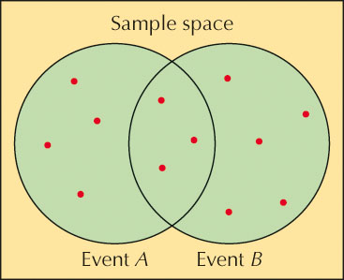
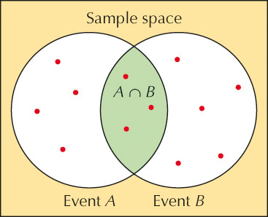


Union and Intersection
Sometimes we need to find the probability of a combination of events.
Union and Intersection of Events
The union of two events A and B is the event representing all the outcomes that belong to A or B or both.
The intersection of two events A and B is the event representing all the outcomes that belong to both A and B.

Slide 14
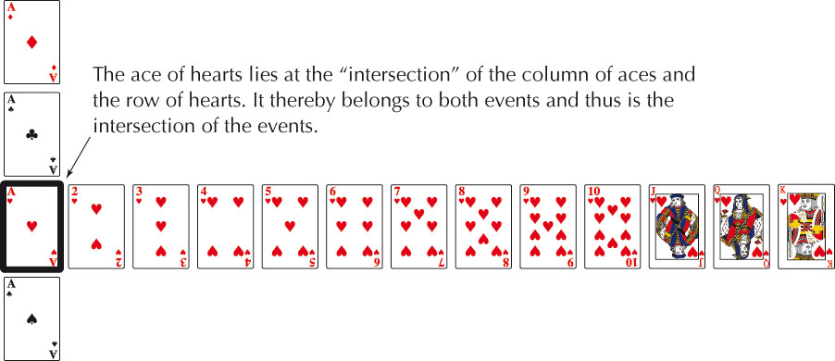
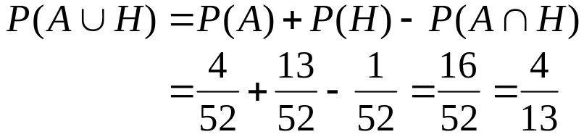
Addition Rule
We are often interested in finding the probability that either one event or another event may occur.
Addition Rule
Find the probability of drawing an ace or heart from a fair deck of cards.

Slide 15
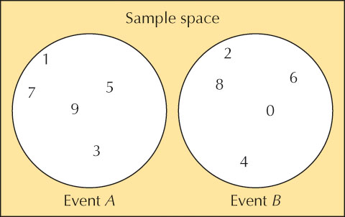

Mutually Exclusive Events
Sometimes, events have no outcomes in common. In this case, we say the events are mutually exclusive.
Two events are said to be mutually exclusive, or disjoint, if they have no outcomes in common.
Note, any event and its complement are always mutually exclusive.
Addition Rule for Mutually Exclusive Events
If A and B are mutually exclusive events,

Slide 16
5.3: Conditional Probability
Objectives:
Calculate conditional probabilities.
Explain independent and dependent events.
Solve problems using the Multiplication Rule and recognize the difference between sampling with replacement and sampling without replacement.
Approximate probabilities for dependent events.

Slide 17
Independent Events
If the probability of one event is unaffected by the occurrence of another event, we say the events are independent.
Events A and B are independent if
Otherwise, the events are said to be dependent.
Strategy for Determining Whether Two Events Are Independent
Find P(B).
Find P(B|A)
Compare the two probabilities. If they are equal, A and B are independent. Otherwise, A and B are dependent events.

Slide 18
5.4: Counting Methods
Objectives:
Apply the Multiplication Rule for Counting to solve certain counting problems.
Use permutations and combinations to solve certain counting problems.
Compute probabilities using combinations.

Slide 19
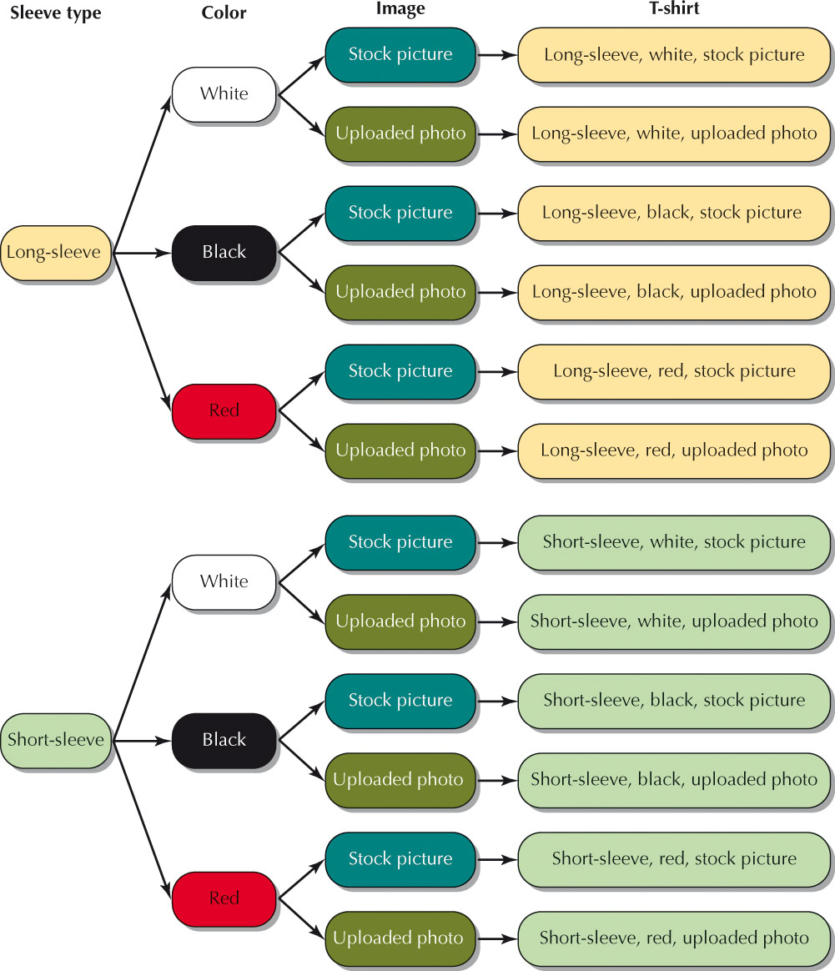
Multiplication Rule for Counting
Counting methods allow us to solve a range of problems, including how to compute certain probabilities.
Multiplication Rule for Counting
Suppose an activity consists of a series of events in which there are a possible outcomes for the first event, b for the second event, c for the third event, and so on. Then the total number of different possible outcomes for the series of events is:
a • b • c • …

Slide 20
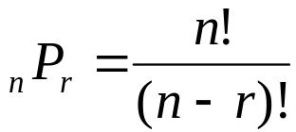
Permutations
Some of the counting rules we encounter involve the factorial symbol.
For any integer n ≥ 0, the factorial symbol n! is defined as follows:
0! = 1
1! = 1
n! = n(n - 1) (n - 2) (n - 3)…3 • 2 • 1
Permutations
A permutation is an arrangement of items, such that:
r items are chosen at a time from n distinct items
repetition of items is not allowed
the order of the items is important
The number of permutations of n items chosen r at a time is denoted as _{n}P_{r}, and given by the formula

Slide 21
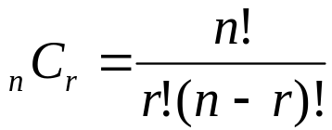
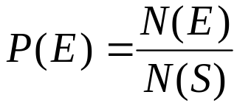
Combinations
In permutations, order is important. Sometimes, order is not important.
Combinations
A combination is an arrangement of items in which:
r items are chosen at a time from n distinct items
repetition of items is not allowed
the order of the items is not important
The number of combinations of r items chosen from n items is denoted as _{n}C_{r}, and given by the formula
The counting methods in this section may be used to compute probabilities. We assume each possible outcome in a random sample is equally likely, and thus the probability of an event E is

